Slide 1
Notes:
Confirmation, Conviction and Cosmology
Ockham Lecture Feb 25 2019
The past sixty years have seen the transformation of cosmology from a weakly constrained metaphysics to a scientific description based on careful observation and accurate measurement. We now know that the universe expanded from a hot beginning to its present state, dominated by an unidentified "dark matter" and an enigmatic "cosmological constant". In a similar fashion to what has happened with particle physics, this "standard model" provides a basis for relating the narrative history of galaxies, stars and planets. It also also establishes a starting point for discussion of more fundamental issues, where differences in philosophy find some parallels in the contrasting views of William of Ockham and his contemporaries.

Slide 2
Notes:
These are strange times. The pace of sci/tech change driven by youthful engineers entrepreneurs and enthusiasts has never been faster. Meanwhile there is a growing distrust in the very same rational thinking that underlies this change. Much of this disconnect derives from unfamiliarity with what lies “under the hood”; some originates in a fear of change. The former represents a serious communication failure for which all parties must share blame, including, especially, those who seek to profit from ignorance. The latter, the fear, is justified. Understanding and opportunity can be harnessed either to avert or to accelerate existential threats but the jockey has fallen from the saddle.

Slide 3
Notes:
Tonight I am going to ignore this sententious introduction and tell you, instead, about cosmology - the study of the origin evolution and future of the universe at large – a subject that dictionaries associate with both metaphysics and astronomy. However, not quite. Cosmology today is also unrecognizable from sixty years ago, largely through the application of technology to grand challenges. Furthermore. through our ambition and excitement, we have paid too little attention to the dislocation this progress may cause in societies derived from different belief systems. So, tonight, I wish, with the broadest brush strokes, to explain what has been learned, to sggestwhat is knowable soon and to discuss topics that are likely to remain rooted in metaphysics for a while, without surrendering their fascination. I would also like to explore a few connections to a larger context, touching on the history of ideas, literature, religion and so on because I have long believed that such humanizing metaphors are vital aids to communication and are capable of actually enhancing the craft of even the most austere and focused scientist.

Slide 4
Notes:
Cosmology has a long and storied history. Few cultures have lacked curiosity about the sky or creation myths. Scientists have often seen cosmology as a speculative safety valve and do not have a good record. As Lev Landau liked to say, cosmologists are always in error and never in doubt. Tbeories have been developed with immense conviction and technical ingenuity and are now completely ignored because their consequences were not confirmed. This is what I meant by my title. A good example is the steady state theory of Hoyle, Bondi and Gold. This was very popular in Britain in the 50s. I do not know if this was due, as some have suggested, to a world view of an empire on which the sun never sets in contrast to the revolutionary legends of the Soviet Union and the United States where Hoyle’s ironic Big Bang seemed more natural and which turned out to be correct.

Slide 5
Notes:
So where is cosmology today? Before I tackle this, I must first explain what is meant by the standard model of the universe - a description that does not, can not go into too much detail and only captures the largest scale features. This is why we call it a model. It is also standard in the sense that most practicing cosmologists think that it is essentially correct. I said think because they do this in response to so many consequences of the model, without serious exception, being validated by observation and experimental measurement. This is the confirmation of my title and it needs to be distinguished from belief, to which I will turn. In fact there are now so many observations that I cannot begin to explain them and can only try to communicate the essence of the model. If this leads you to seek out and critique the observations, then I will have done my job.

Slide 6
Notes:
Perhaps some of you will end up siding with a small minority of my colleagues including at least two from Oxford who take issue with the standard model and whose outlook I highly respect. This is the essence of a healthy science. So the standard model holds sway in the same sense as the standard model of particle physics. It is accepted so far as it goes.

Slide 7
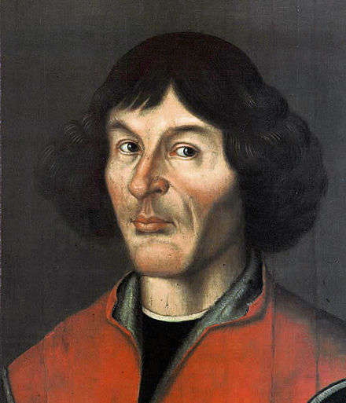
Notes:
When we observe the universe on the largest scale, we are studying both geography and history because light travels at a finite speed. It appears to be isotropic ands, so far as we can tell everywhere we can see has had a similar history.
We are not special and the universe is consequently homogeneous at the same time. This principle is rightly associated with Copernicus but it can be traced back to Aristarchus ~ 300 BCE who formulated the heliocentric view with the planets in circular orbits about the sun. Yhis was adopted by Archimedes.The stars were affixed to a large sphere. Aristotle replaced the circles with spheres centered on the earth bounding four and eventually five elements and used a lot of belief to supplement observation. More conviction. Aristotle’s views were widely accepted for 18 centuries. However as most of you know Johannes Kepler used Tycho Brahe’s observations to confirm the heliocentric view and confirm his conjecture that the planetary orbits were ellipses. So much for conviction.

Slide 8
Notes:
The next step was taken by the unfortunate Bruno in Italy and an English astronomer called Thomas Digges who saw the stars as extending through infinite space. He may have been the first to recognize that this implied that any line of sight should eventually intercept a star and the night sky should be bright.
As a side story, Digges died in 1595 and his widow, Anne, had moved to Stratford by the time William Shakespeare wrote Hamlet, which is replete with astronomical imagery. For example, Hamlet says that “I could be bounded in a nutshell and count myself a king of infinite space” to Rosencrantz and Guildenstern which are also the names of Tycho Brahe’s, cousins acknowledged in the Starry Messenger. Anne’s second husband was Shakespeare’s executor. Such facts might inform suggestions that the Earl of Oxford wrote the plays, posthumously.

Slide 9
Notes:
Let us return to the universe. We have known for almost a century thanks, to Slipher and Hubble, that it is expanding in a uniform way so that the local recession velocity increases with distance. Here is Hubble’s original plot with velocity measured in km. This solves the bright night sky problem because receding stars will appear dim due to their Doppler or red shift. It also allows him to estimate the age of the universe which we now calculate as 13.8 Gyr about 8 times Hubble’s estimate. Actually, the best measurement today claims an accuracy of one percent but there are some independent measurements that give an age as much as ten percent younger. What I have to say is robust to this change should it be necessary but the important point is that it is not so long since we were arguing about a factor two range of possibilities.

Slide 10
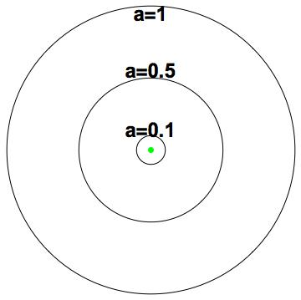
Notes:
So the universe at large is expanding like a 3D balloon. Observationally, it is more convenient to think of the size of the universe in proportion to its size today – we call this the scale factor, a – instead of the time. This is because the wavelength of waves like light expands in proportion to a and this is what we often measure. For example a spectral line emitted by hydrogen atoms with a wavelength 21 cm when a was 0.5 will be observed with a wavelength of 42 cm today. We call this a redshift – even at radio wavelengths.

Slide 11
Notes:
So far, I have just talked about space and time. This is called kinematics and it is what Galileo considered. As a young man he was a follower of Aristotle a scholastic - and argued quite cleverly that if he dropped something its speed would increase in proportion to distance. He famously made measurements to test his conviction, although he may not have dropped a cannonball off the tower at Pisa. He famously discovered that the speed increased with time and is a known a little unfairly as the father of experimental science. Unfair because some of William of Ockhams contemporaries, not to mention the Arab and Greek sources they were reading, were also making experiments. Similar approaches developed in China and India.

Slide 12
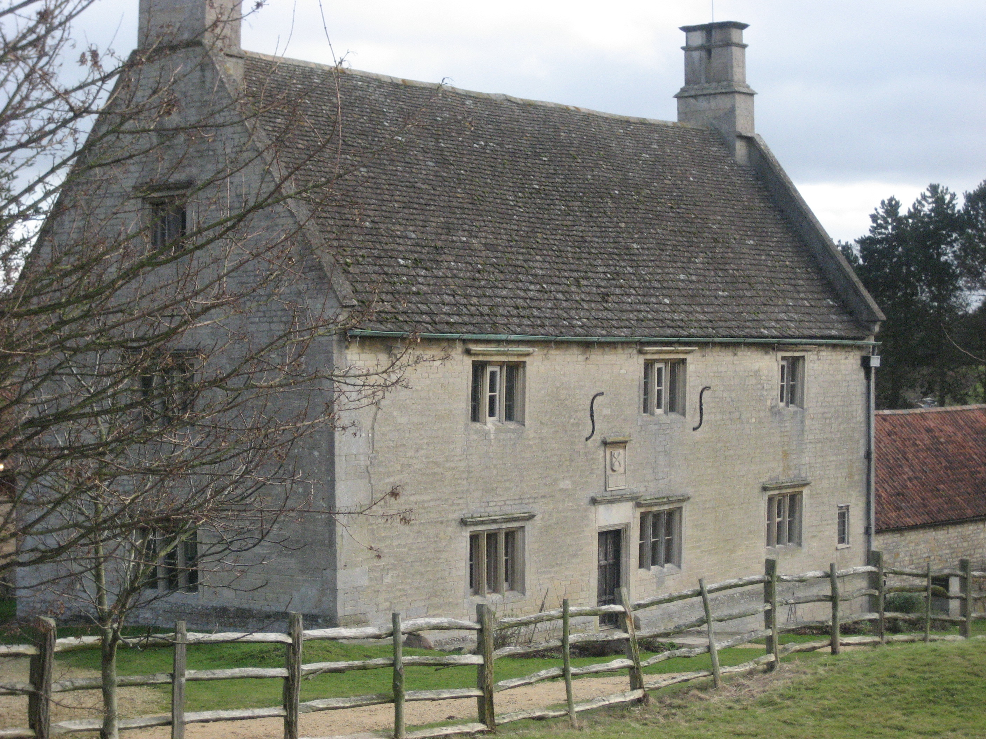
Notes:
So with Galileo and Kepler sorting out the kinematics it fell to Isaac Newton to explain what was meant by a force and to sort out the dynamics. Here is Woolsthorpe, where Newton related the force of gravity that made the moon accelerate to the force that dropped the apple, again probably metaphorically, and showed that it varied as the inverse square of distance. You can see this is where calculus was invented because of the integral signs carved into the wall. (Actually, that is a cruel joke because the integral sign was introduced by his bitter rival Leibniz.) I boast that I was born four miles away from Woolsthorpe but my students are totally unimpressed.

Slide 13
Notes:
Anyway, Newton explained that force was proportional to acceleration and recovered elliptical orbits as shown on the back of this old one pound note with the sun helpfully depicted at the center of the ellipse. No wonder they discontinued it. Anyway this Newtonian view, augmented by clever calculational techniques based upon energy more than force never failed when used appropriately and to this day remains the basis of most engineering because its principles were abundantly confirmed. Most physicists in the nineteenth century developed the conviction that this would always be the case.

Slide 14
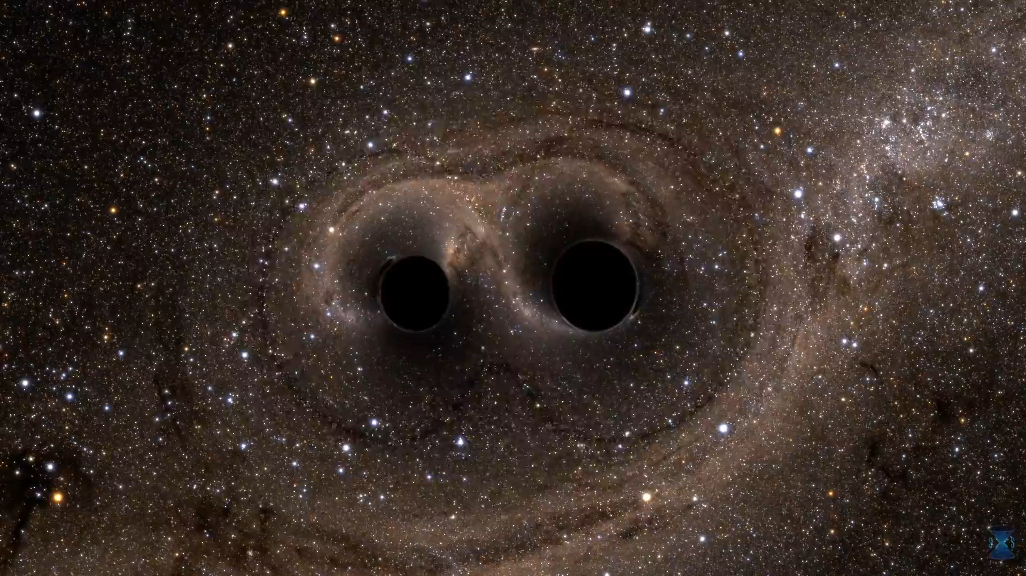
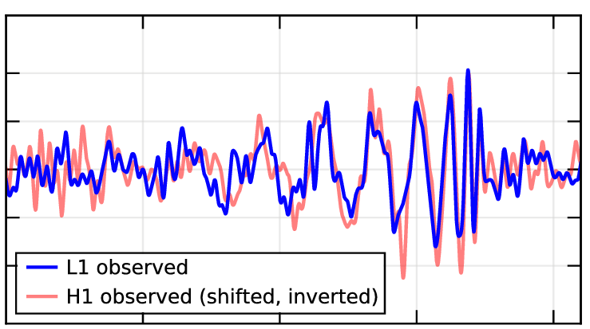
Notes:
Galileo and Newton also realized that the moon, an apple and a coin would follow the same orbit if they started at the same time and place with the same velocity and thought this curious.So did Albert Einstein who developed a completely different physical model called general relativity in which space and time are united as spacetime which is curved by all the stuff in the universe. The moon and sixpence follow “straight’’ lines in curved spacetime which almost always looks just the same as if Newton’s forces were at work. The best exceptions involved speeds that approach the speed of light and there are now many experiments that have tested general relativity and so far it has never failed. In particular it predicts the radiation of gravitational waves which has been quantitatively validated indirectly and most recently directly by the LIGO and VIRGO experiments. In a related fashion, under relativity, mass – the quantity of matter - is related to energy through a well known equation and it is more useful now to think in terms of energy than of force.

Slide 15
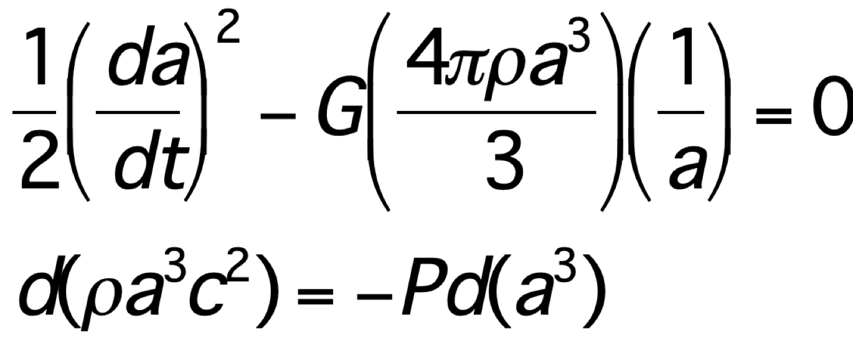
Notes:
However, given this experience, physicists do not have tan automatic conviction that general relativity also applies to cosmology. Instead, they adopt it as a working hypothesis and sought confirmation that it works. So far, with one important qualification, which I will discuss, it does very well and no cause for doubt has emerged. The equations that are necessary are simple and look like a Newtonian energy equation and the first law of thermodynamics. The first similarity is quite deceptive. In particular the energy term that looks like it is missing from the right hand side corresponds to spatial curvature and this can measured as being small. I will ignore it.

Slide 16
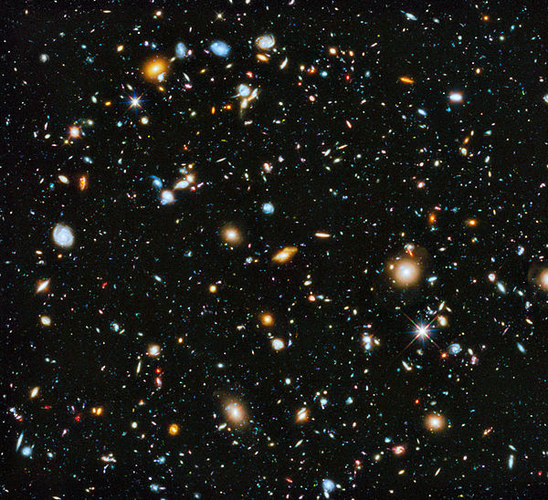
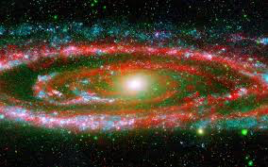
Notes:
Let us look at the universe today and its contents. In our chauvinist way, we must start with regular matter, atoms, molecules and plasma, which we call baryons. We now know that is only 5% of the total average mass energy. On average protons are just under 2m apart. Interestingly, the first person to attempt this estimate was Archimedes. In the Sand Reckoner, he argued that the universe is equivalent to 10^63 grains of sand. (I have reason to believe that the old Eureka streaker knew how to relate volume to mass and so this is equivalent to 3x10^52 kg.) Now the modern calculation of the baryon mass of the observable universe is three times larger. Good enough for government work. I am not saying that had Archimedes not been slain by a clueless Roman soldier, he would have used his calculus to derive the field equations of general relativity. This is a lucky coincidence as Archimedes’ universe is only six light years across. However, there are clear intellectual threads that can connect contemporary views with selected features of ancient academic and religious traditions and we should not be afraid of them.

Slide 17
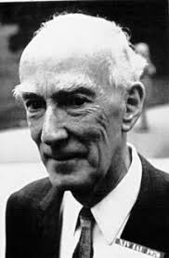
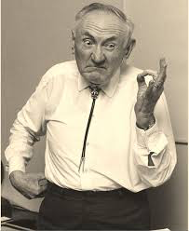
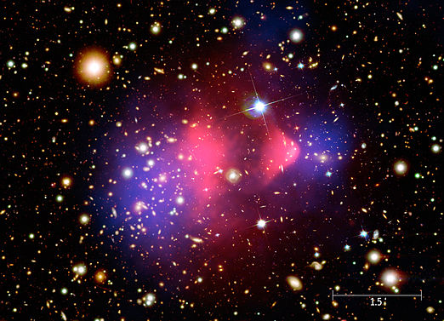
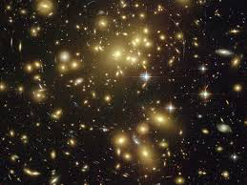
Notes:
The next constituent is now called dark matter. It was first found in the 1930s by Oort and Zwicky and we now know that it has just over five times the density of baryons. Various ideas about its identity and provenance have been explored experimentally but there is no evidence that it has any of the interactions of other particles. It has proved as elusive as Macavity and cannot be convicted. (Unlike said cat, though, it does appear to obey the law of gravity.) In particular a galaxy should be thought of as a large gravitational potential well formed by dark matter with a smaller central puddle of light-emitting baryons. As Eliot also said, Between the motion and the act, falls the Shadow.” Giant clusters of thousands of galaxies should be considered in the same way. The quest for dark matter below ground in mines, on ground at accelerators and above ground with gamma ray telescopes is a large enterprise and its failure is anything but this. It is experimental physics at its finest. Please see me afterwards with any better ideas.

Slide 18
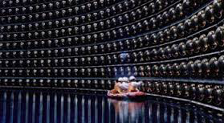
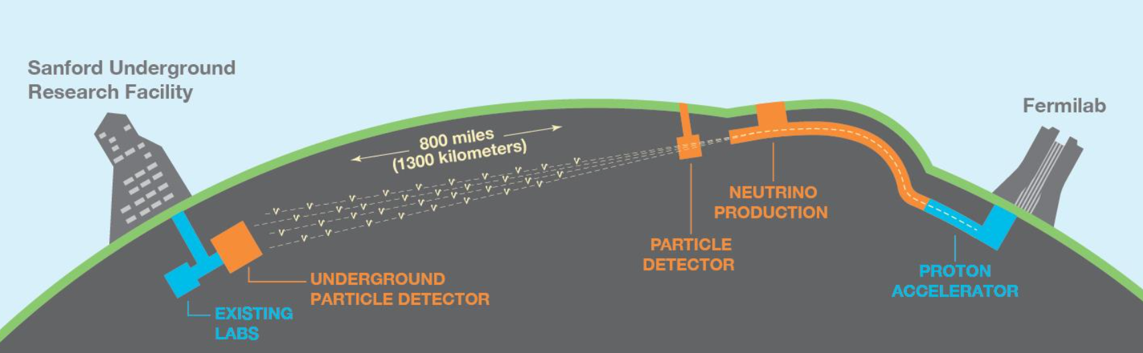
Notes:
The third constituent is neutrinos. Again, we only infer their presence. However, we know their properties and that they come in three flavours. They have very small masses and cosmology is being combined with laboratory experiments to measure them. They account for less for only a fraction of a percent of the universe today.

Slide 19
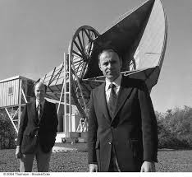
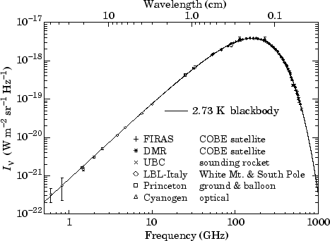
Notes:
The fourth component is radiation and although its mass contribution today is negligible, it is worth dwelling upon because it was dominant in the past and it has told us more than half of what we know. We see it as the cosmic microwave background black body radiation with a 3K temperature discovered in 1964 by Penzias and Wilson. Its central wavelength is about 1mm and most of it comes directly to us from a time when the universe was a thousand times smaller and its wavelength was consequently a micron. It was like being in the atmosphere of a red star like Betelgeuse and the baryons were just changing from an ionized plasma with electrons freed from protons to hydrogen atoms. This is called, incorrectly, recombination.

Slide 20
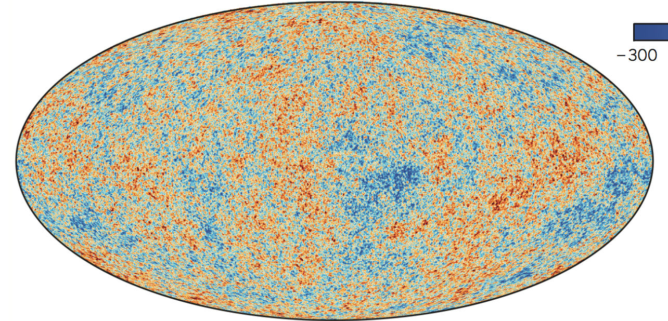
Notes:
At this point you should be asking how did structures like giant clusters of galaxies come to be. The answer is that tiny departures from uniformity – about ten parts per million - in the density of dark matter grew under gravity to make these structures today and that we can see them in small fluctuations in the background radiation. Studying the correlations of these fluctuations which depends, upon very basic and simple physics, is what has taught so much and continues to do so.

Slide 21
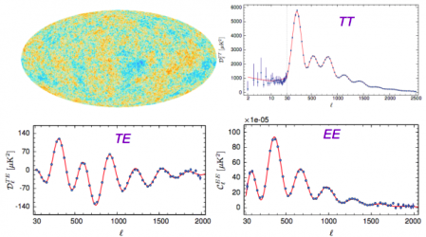
Notes:
In particular looking at correlations on different angular scales provides much quantitative measurement. You can see theory and observations match beautifully with essentially six adjustable parameters. This is very strong confirmation. William of Ockham would surely smile on this figure.

Slide 22
B
Notes:
We now turn to the final component which accounts for 69% of the universe today. I will call it the cosmological constant though you often hear it referred to as dark energy. The cosmological constant was introduced by Einstein in 1917 for a very good reason. It is a single number representing an energy density that has the same value everywhere and always and also if we move through it at high speed. We can think of it as an essential part of the general relativity equation conferring a scale in much the same way as Planck’s constant confers a scale to Schrodinger’s equation. Alternatively, we can treat it as just more stuff to source gravitation. If we take the second approach then it has unfamiliar properties. It has negative pressure equal in magnitude to its energy density. Actually, there is a precedent for this. A uniform magnetic field, viewed in one dimension has this character. If it permeates a cylinder and we withdraw the piston, the work done is the increase in energy consistent with the first law of thermodynamics I showed you.

Slide 23
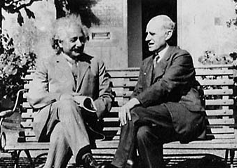
Notes:
The history is instructive. Einstein used it to make a static model universe which turned out to be unstable. However, others realized that it could be part of an expanding universe and cause it to accelerate and this is how it was first detected. Another catholic priest, Georges Lemaitre, with extraordinary and consistent prescience took it very seriously and said in 1933 that “The expansion thus took place in three phases, a first period of rapid expansion in which the atom universe was broken into atomic stars, a period of slowing down, followed by a third period of accelerated expansion.” Eddington had even stronger conviction in the same year. “I would as soon think of reverting to Newtonian theory as of dropping the cosmical constant…to drop the cosmical constant would knock the bottom out of space.”
In his 1951 textbook, Bondi wrote down and solve the equations that we use today. In my first formal instruction, it was seen as a quantity to be measured without prejudice.

Slide 24
Notes:
However, in the 1980s, when particle theorists discovered cosmology, they mostly found the cosmological constant to be repugnant because its “natural” value was 10^123 times larger than what it might be and so, they reasoned, some symmetry should render it zero. This raises an interesting point. Underlying this concern is a conviction that all physics is ultimately derivable from the smallest scale. There are emergent phenomena like ferromagnetism, but the spin behavior that this needs depend upon the properties of electrons and nuclei, which depend upon quarks and so on. This is called reductionism and most particle physicists have the conviction that it is always present. In particular gravity must ultimately yield to the prerogatives of quantum mechanics. I have no objection to this conviction but have never seen it as necessary the square peg of quantum field theory need not be forced into the round hole of general relativity.

Slide 25
Notes:
Perhaps the cosmological constant is our first glimpse of physics on the largest scale, just like black body radiation, specific heats and the thermoelectric effect revealed the world of the small. Consider, allegorically, a bug in a still pond. A fish swims by, and the bug finds itself in the fish’s turbulent wake. It observes that its food is moving with an average speed that increases as the cube root of its distance. If the bug desires to reconcile its observations with their causes, it is to the outer scale of a turbulent spectrum that it should turn, not to the properties of water molecules. Allow me a second analogy. Imagine a sailor climbing a mast on a boat in the middle of the ocean. There is water as far as he can see, perhaps ten miles. Yet he knows that the world is large and curved and this is the source of the gravity and the weather. Could something similar be occurring in cosmology?

Slide 26
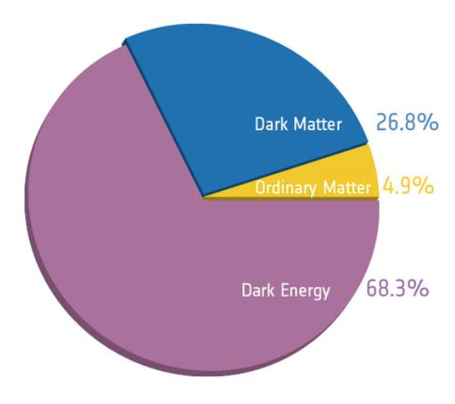
Notes:
It is time to take stock. The modern universe has five major ingredients that in some whimsical way have replaced the same number of Aristotelian elements. Here they are as a pie chart. This is all we need to reconstruct the history of the universe as far back as we are confident that we understand the physical processes involved.

Slide 27
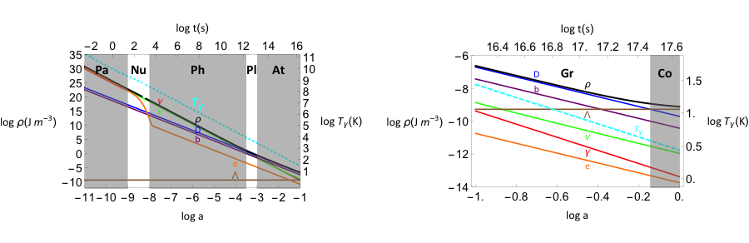
Notes:
I like to describe this by starting when a~ 10^-11. The universe was a few ms young and its temperature was ~10^11K and elementary particles were created and destroyed freely. I call this the particle age. As the universe expanded and cooled, it passed though six more ages when important things happened. During the nuclear age the observed fraction of helium and deuterium was set down. During the radiation age, the expansion was controlled by the photons; dark and baryonic matter took over during the plasma age which ended at recombination when atomic hydrogen formed and the age was 380,000 years. Next, came the atomic age when the first structures formed. These can be observed as young stars, galaxies and quasars.

Slide 28
Notes:
In ways that we do not understand, they were able to ionize the gas outside the galaxies and this has a profound influence on how the majority of galaxies including our own were formed in the gravitational age. Finally we have the cosmological age when the cosmological constant became dominant. Going forward, we can look forward to an accelerating exponential expansion with endless dilution and decay, an agoraphobic ‘s worst nightmare.

Slide 29
Notes:
This story is compelling and has been well-confirmed. However, it raises a second interesting question like the puzzle of the dark night sky. I said that the universe was a few milliseconds old at the start of the particle age. As you know, nothing can travel faster than the speed of light expect, perhaps, a rumour, which is allowed as it carries no information. This time was insufficient for the entire universe we observe today to have been homogenized. The problem gets worse as we go back in time. How can this be?

Slide 30
Notes:
The answer to this riddle is that universe started off as homogeneous on a scale that encompasses more than we observe today and then underwent a period of cosmological constant-like exponential expansion so that the homogenized universe got out of causal contact and then after this epoch, called inflation, ended, the universe came back into view across our horizon, pre-smoothed. Hello, goodbye, hello again. The simplest models of inflation have simple consequences which, so far, have been confirmed. In particular, there is a generic expectation that the fluctuations that are responsible for the structure in the universe are almost equally strong on all scales and have random phases.as seems to be the case. The universe began with a hum not a fanfare. (I will defer to Eliot’s authority that it will end with a pathetic whimper.)

Slide 31
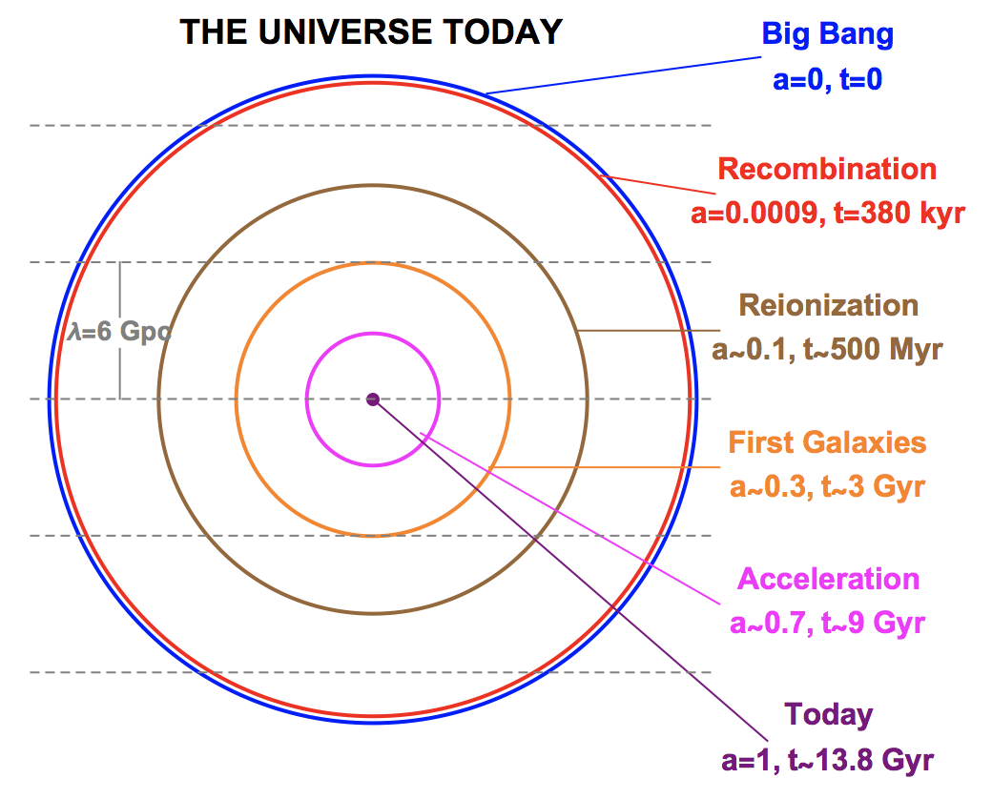
Notes:
What I have described is the standard model of cosmology. Most of it depends on known physical laws and the simplest assumptions about processes that we do not understand. So far, like general relativity itself, it has been pretty well confirmed. However there is still much work to be done on major questions. How did inflation end? What is dark matter and why did it have just the density we measure today. Likewise, how did the baryons form and why is there an excess of them over antibaryons? What happened before inflation began? What lies beyond our current horizon?

Slide 32
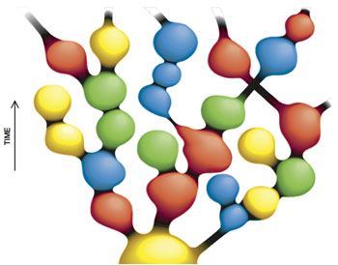
Notes:
The answers to these questions are unknown but they do seem to require special pleading. This has led many cosmologists to contemplate the existence of a multiverse, an ensemble of universes, either real or imagined, that exhibited all possible properties and features. Some formulations of string theory give us 10^500 vacua to consider. The initial conditions may vary; so might the physical laws. Some extreme versions of this line of reasoning vary the laws of arithmetic and logic! The answer to the question “Why are we here?” becomes the principle that our very existence selects the only combination of features that allows life as we perceive it to begin, to develop and to survive. This is called the Anthropic Principle. Instead of our usual view of causality, “Things are as they are because they were as they were”, we have “Things were as they were because we are as we are.”

Slide 33
Notes:
Many physicists find this to be abhorrent, a renunciation of their craft and a descent into metaphysics. Others see it as an inevitable continuation of the methodology of physical reasoning as it has metamorphosed from the billiards table through Bayesian inference, (which is appropriate when you have much data but hypothesis-testing experiments are impossible), to foundational questions where the problems are real but the facts are few and you must ascend into metaphysics for enlightenment. Again it is all too easy to recall the earnest discourses involving Roger Bacon appealing to experiment, William of Ockham saying “Keep it simple” and to Thomas Aquinas trying to divine God’s purpose, all conducted in a time of large political and social change, and to map them on to giant surveys, parameter fitting and earnest quests for more fundamental laws of physics.

Slide 34
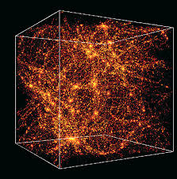
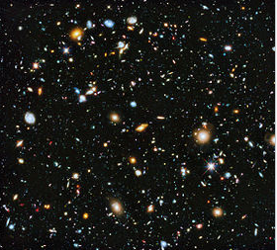
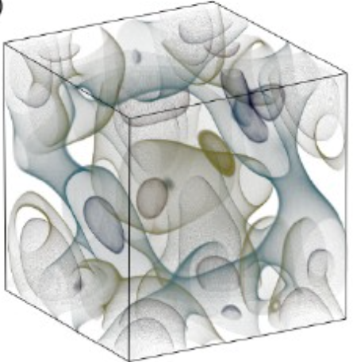
Notes:
So I have tried to present a view of how far cosmology has travelled as a discipline over the past sixty years. Just as the brave and hearty sailors of the fifteenth and sixteenth centuries were on voyages of discovery that might have had quite different outcomes, cosmologists have made clear choices among a rich variety of models of the universe. From a scientific perspective, this has been a glorious success. Where is this all headed? There is still many places on a crowded street where the applecart can be overturned and, personally, I hope this happens,

Slide 35
Notes:
But, if it does not, then my guess – not even a conviction - is that cosmology will make some limited though not widely accepted contribution to our understanding of the properties of neutrinos, that the eschatological expectations of a cosmological constant and the causal consequences of the basic inflation mechanism will be borne out and that the great metaphysical questions will be addressed in a far more philosophically responsible fashion but that additional observational insight into them will be very hard to acquire. Instead, it is the more prosaic and pragmatic investigations that I see making greater progress. As Peter Medawar said, ”Science is the Art of the Soluble”. Making a map of the one entire universe we actually inhabit, initially crude but gradually with more detail. Filling in large gaps in the narrative history of the first galaxies, stars and planets like paleontologists from the nineteenth century by looking near in studying the motion of stars in our Galaxy with the Gaia observatory and far using the James Webb Space Telescope. Discovering new denizens of the universe. Developing a far more sophisticated view of the singularity or of the ubiquity of life.

Slide 36
Notes:
Allow me to return to the viewpoint with which I started. The cosmology story has widespread appeal and can be presented in a fashion that connects strongly to earlier and different traditions without treading on political or religious bunions. It is splendid exemplar of much modern science as it is actually practiced where humans advance as much through failing fast as they do though technique and insight, where conviction is fine but must eventually cede to confirmation and where absolute certainty may often lie beyond the horizon. To the undergraduates here, I implore you to learn what you can and to experiment in communicating it to as wide an audience as you can access. Perhaps in this way we can honour the memory of William of Ockham and do our small part in recovering rational choice and technical innovation as the means to address existential threat on a complicated planet.
I thank you for your interest and your patience.

